Slide 1

Domain: Consumer Goods | Function: Executive Management
Presentation by : SOUMYA GUPTA

Slide 2
AGENDA
Problem Statement
Project Execution process
Company’s background & overview
10 ad hoc requests & Insights
Some additional insights

Slide 3
Problem statement
One of the top manufacturers of computer hardware in India, AtliQ Hardware is also well-established in other countries outside India.
The management did note, nevertheless, that they do not obtain sufficient insights to enable them to take prompt, wise, and data-informed judgements. They intend to grow their workforce of data analysts by hiring additional young data analysts.
Its data analytics director, Tony Sharma, sought a candidate with strong technical and soft skill sets. So, he made the decision to run a SQL challenge that would enable him to better comprehend both talents.

Slide 4
PROJECT EXECUTION PROCESS
Loading AtliQ’s database “gdb023” provided by AtliQ’s data analyst Tony Sharma, in MySQL.
Understanding AtliQ’s background and data related to company’s customers, products, sales, manufacturing costs etc by running sql queries in MySQL.
Query 10 ad hoc requests in MySQL
Then storing the query results as View in MySQL
Loading all the views in Power BI for visualization.
Then document the INSIGHTS in PowerPoint presentation.

Slide 5
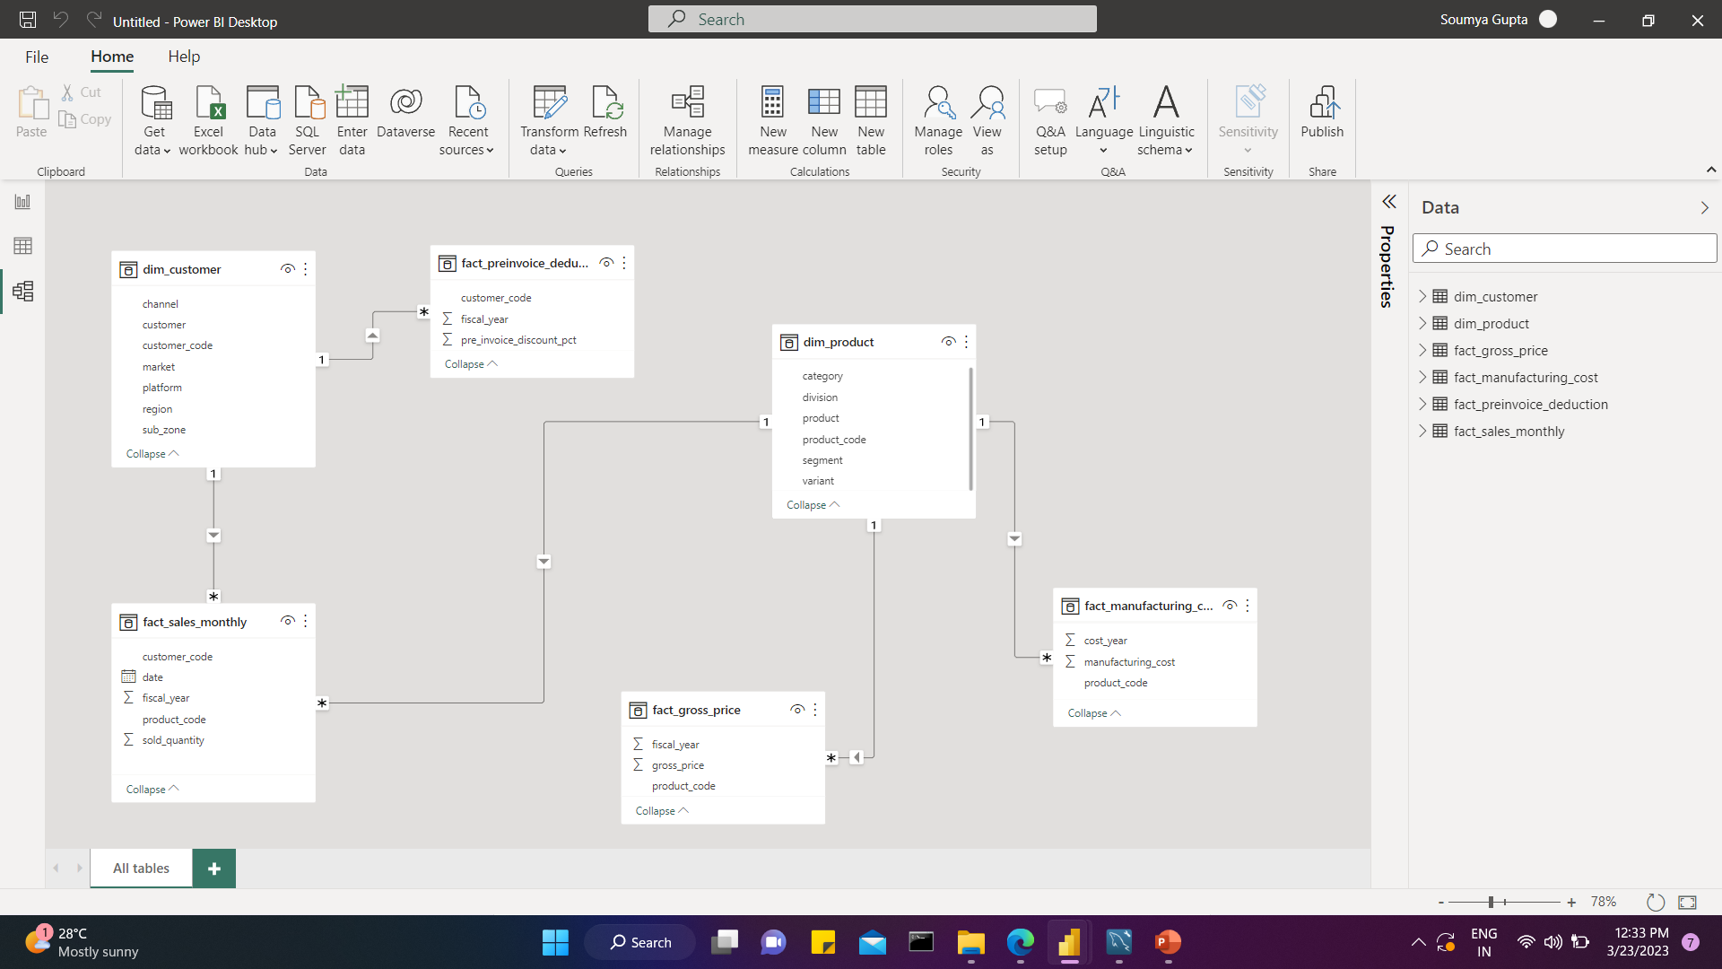
Understanding Data
1. dim_customer: contains customer-related data
2. dim_product: contains product-related data
3. fact_gross_price: contains gross price information for each product
4.fact_manufacturing_cost: contains the cost incurred in the production of each product
5.fact_pre_invoice_deductions: contains pre-invoice deductions information for each product
6. fact_sales_monthly: contains monthly sales data for each product.

Slide 6
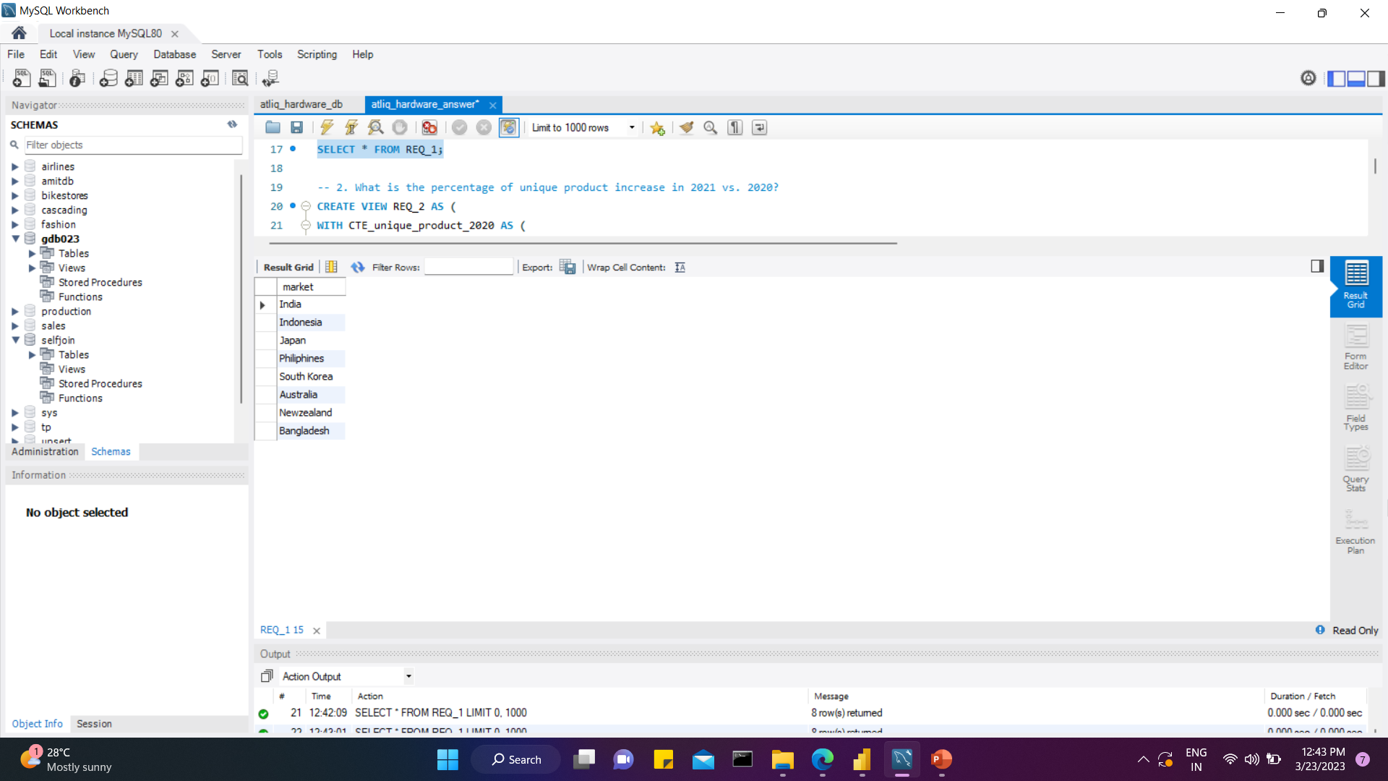
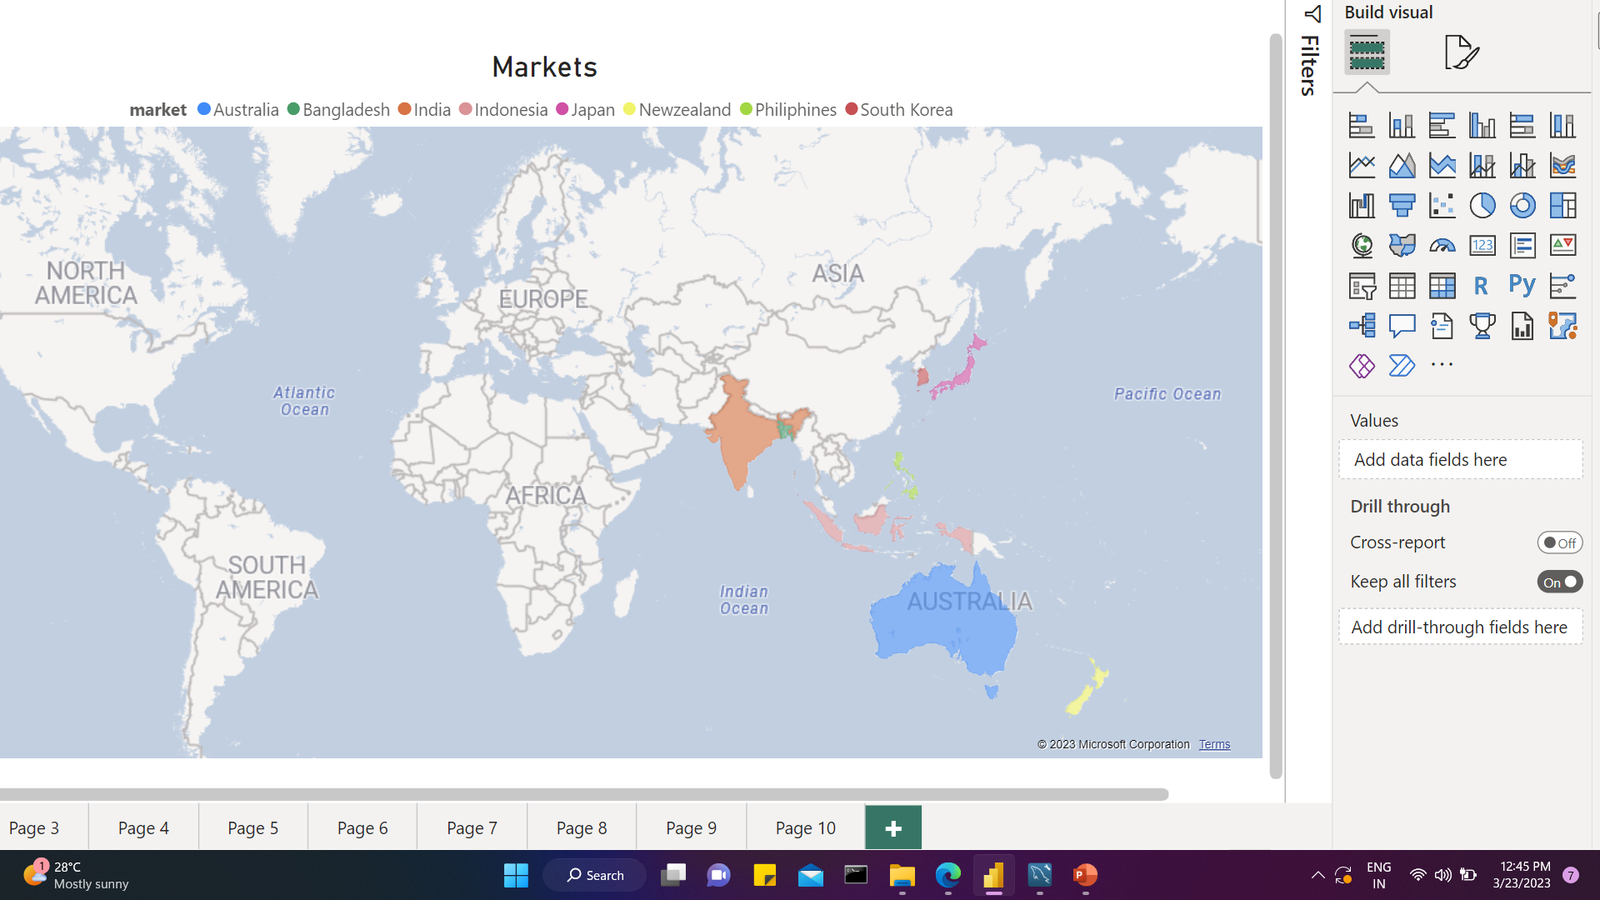
Provide the list of markets in which customer "Atliq Exclusive" operates its business in the APAC region
Req 1
INSIGHTS
"Atliq Exclusive“ operates its business in 8 countries in APAC region.
Of these, India has the highest number of customers.

Slide 7
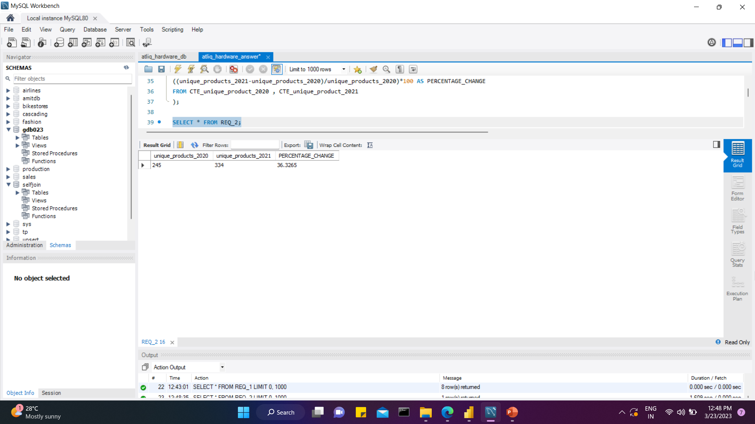
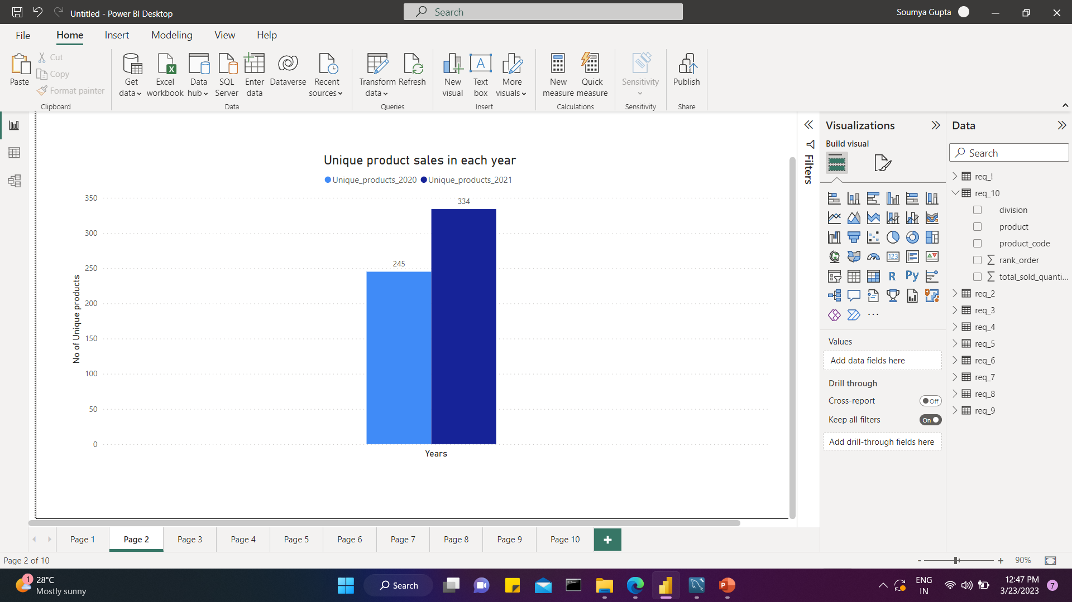
What is the percentage of unique products increase in 2021 vs. 2020?
Req 2
INSIGHTS
We observe a 36.33% upgrade in the number of unique products from 2020 to 2021.
AtliQ is well competing with their competitors and discovering market opportunities by launching new products. This tactic helps to attract new potential customers and ring up sales for both old and new products.

Slide 8
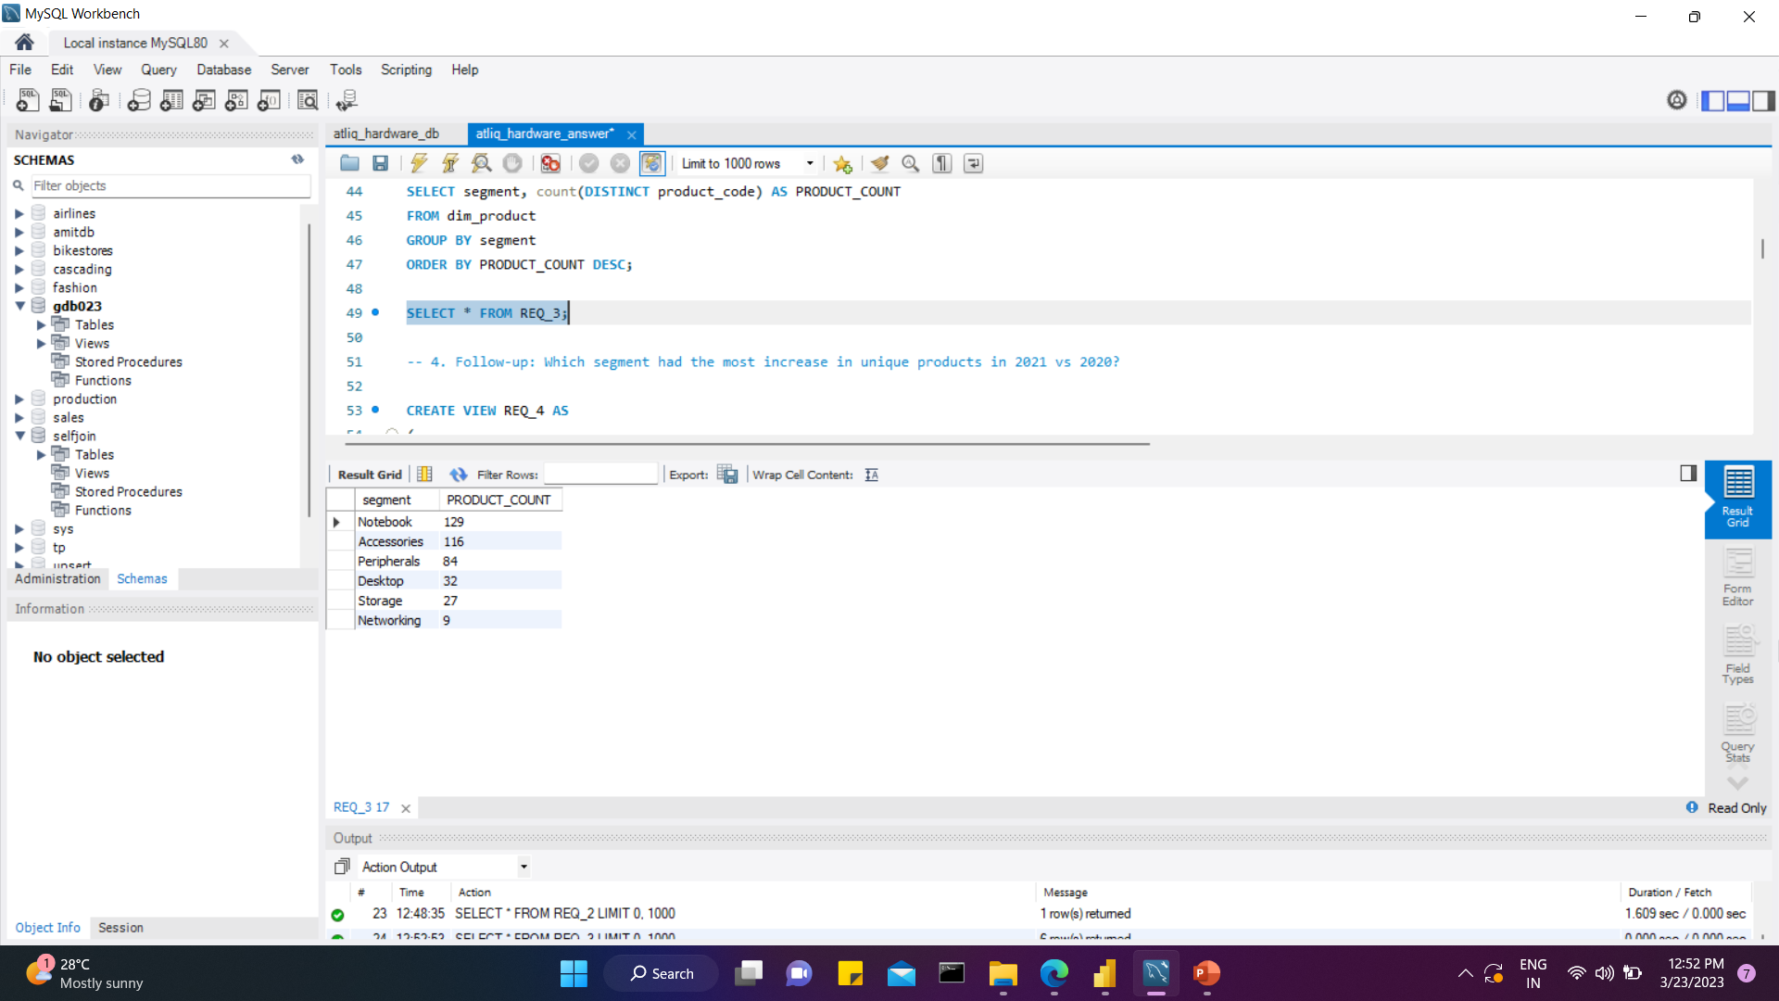
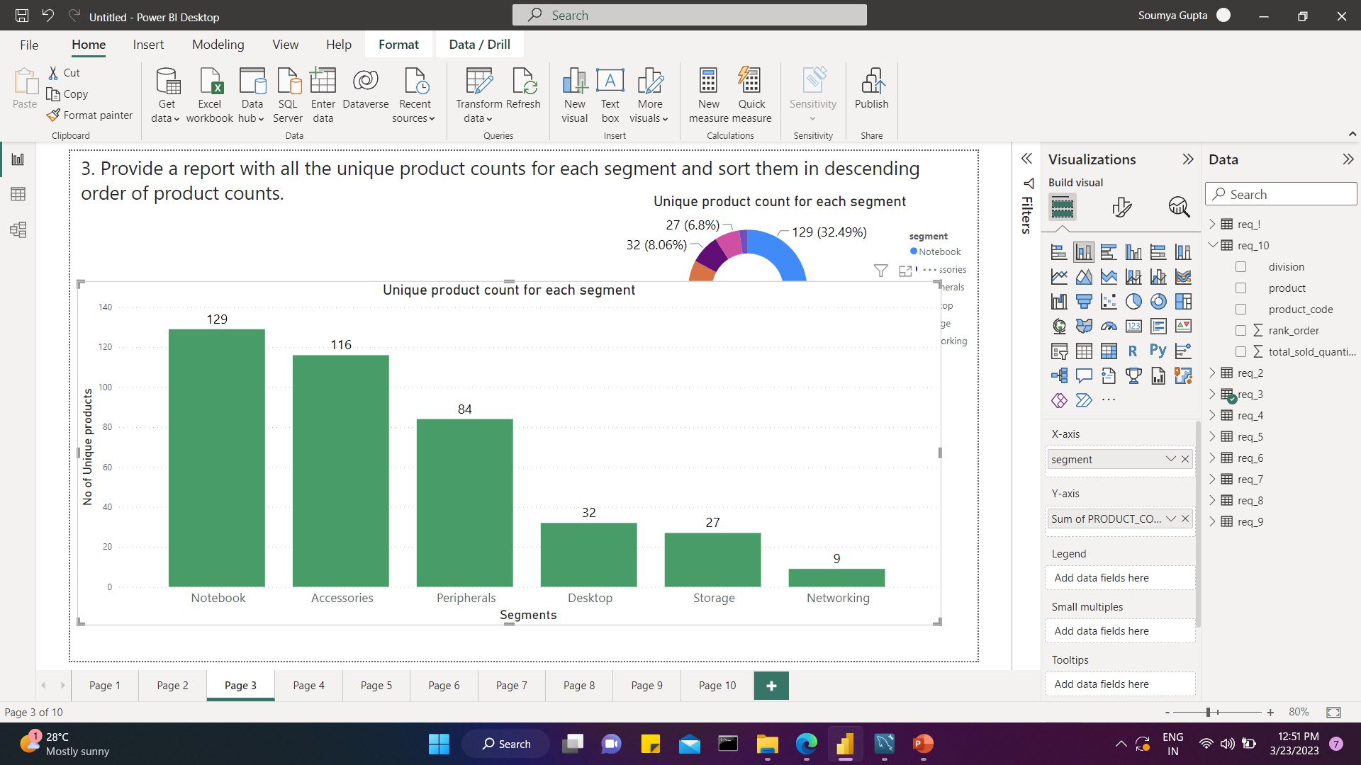
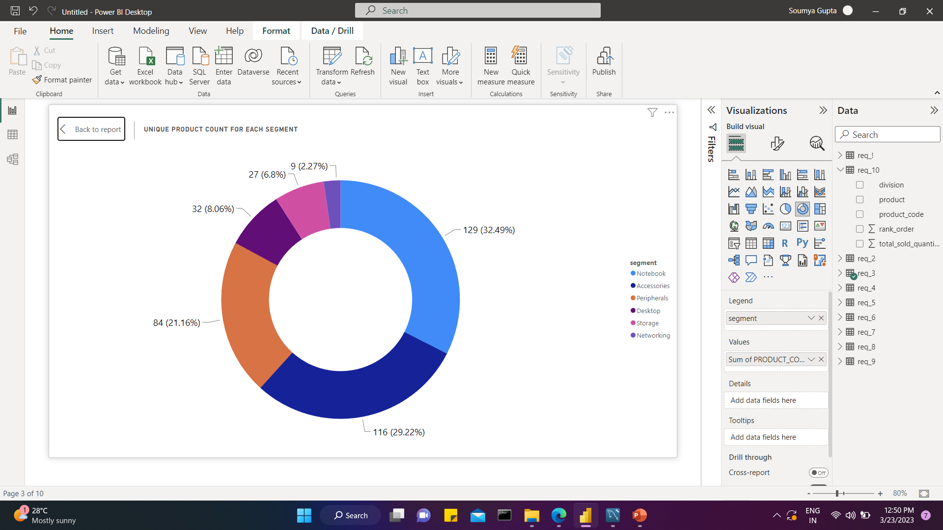
Provide a report with all the unique product counts for each segment and sort them in descending order of product counts.
Req 3
➢ The most unique products are found in the Notebook segment
➢ This segment wise analysis aids AtliQ in determining where attention should be paid to aim growth
INSIGHTS

Slide 9
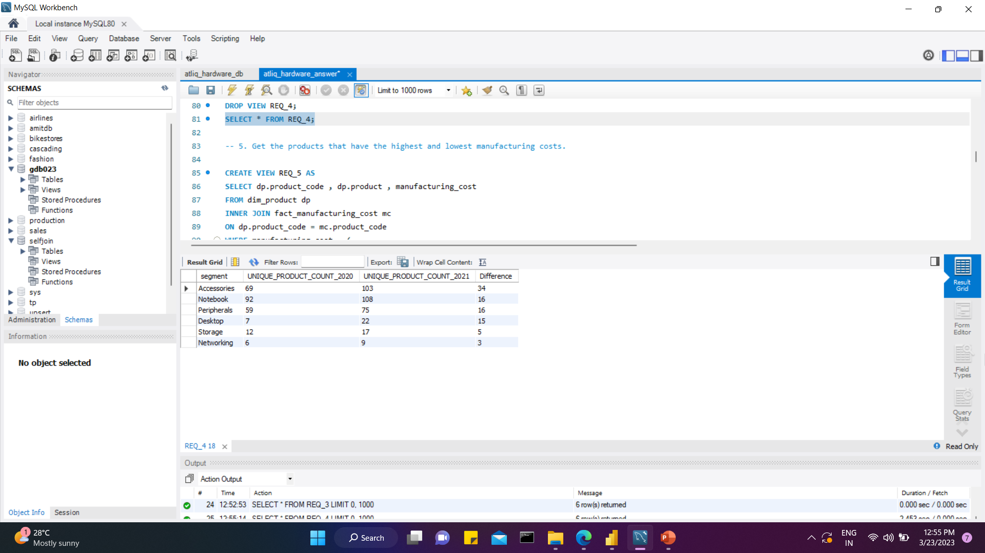
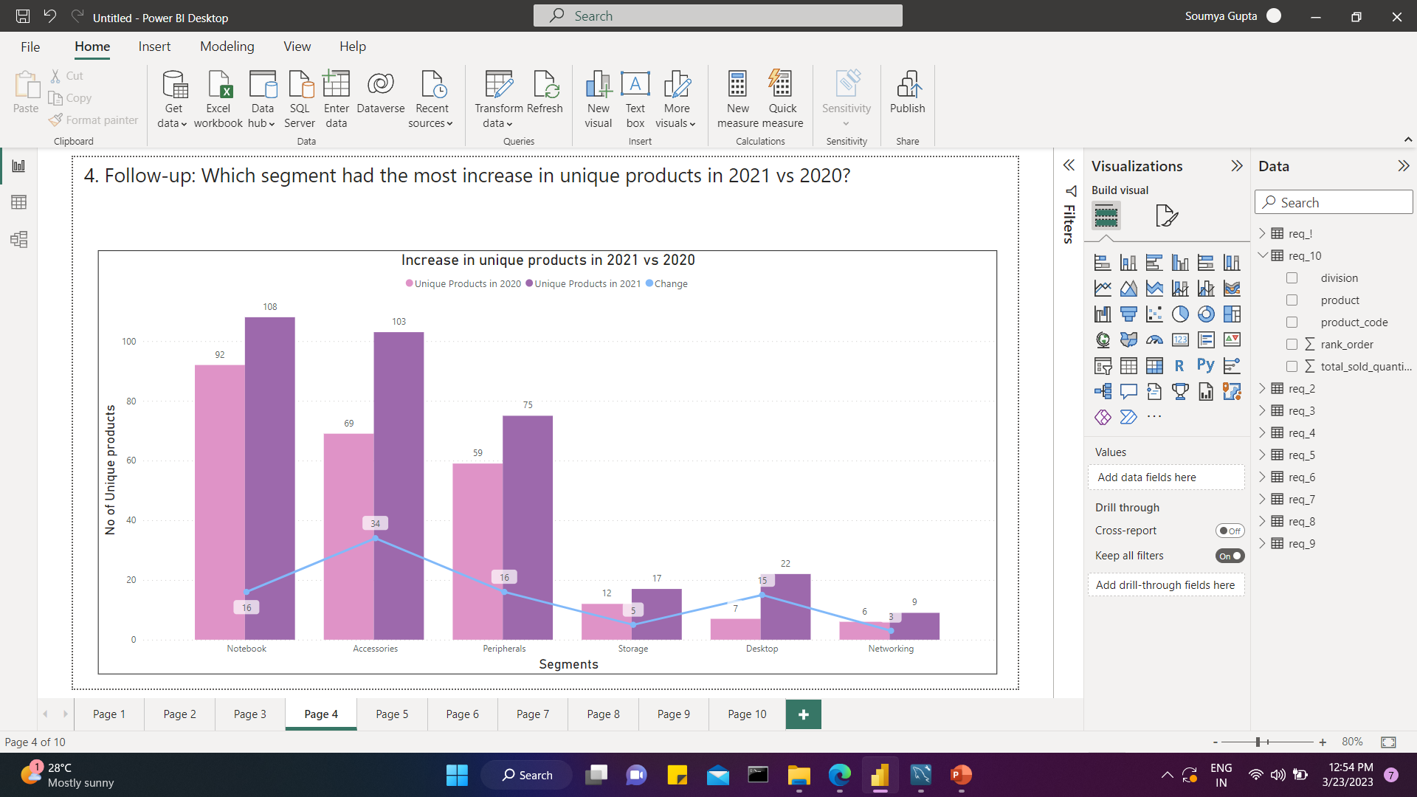
Which segment had the most increase in unique products in 2021 vs 2020?
Req 4
INSIGHTS
➢ Accessories segment had the most increase(34) in unique products from 2020 to 2021.
➢ Percentage of change in product count from 2020 to 2021 had skyrocketed by 214% in desktop segment
➢ N & S division(Networking and Storage segments) had the least increase(8) in products from 2020 to 2021.

Slide 10
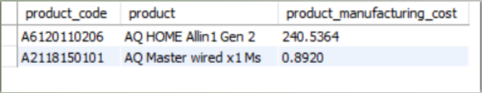
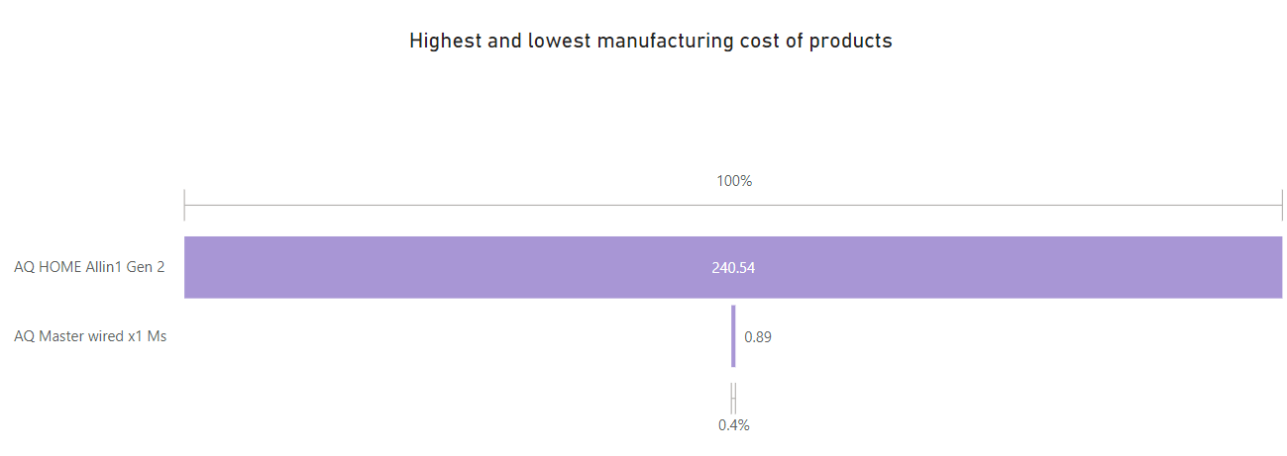
Get the products that have the highest and lowest manufacturing costs.
Req 5
INSIGHTS
➢ Accessories segment had the most increase(34) in unique products from 2020 to 2021.
➢ Percentage of change in product count from 2020 to 2021 had skyrocketed by 214% in desktop segment
➢ N & S division(Networking and Storage segments) had the least increase(8) in products from 2020 to 2021.

Slide 11
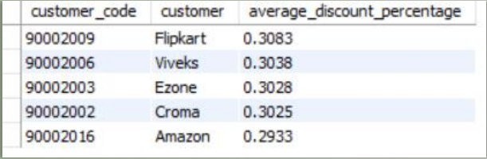
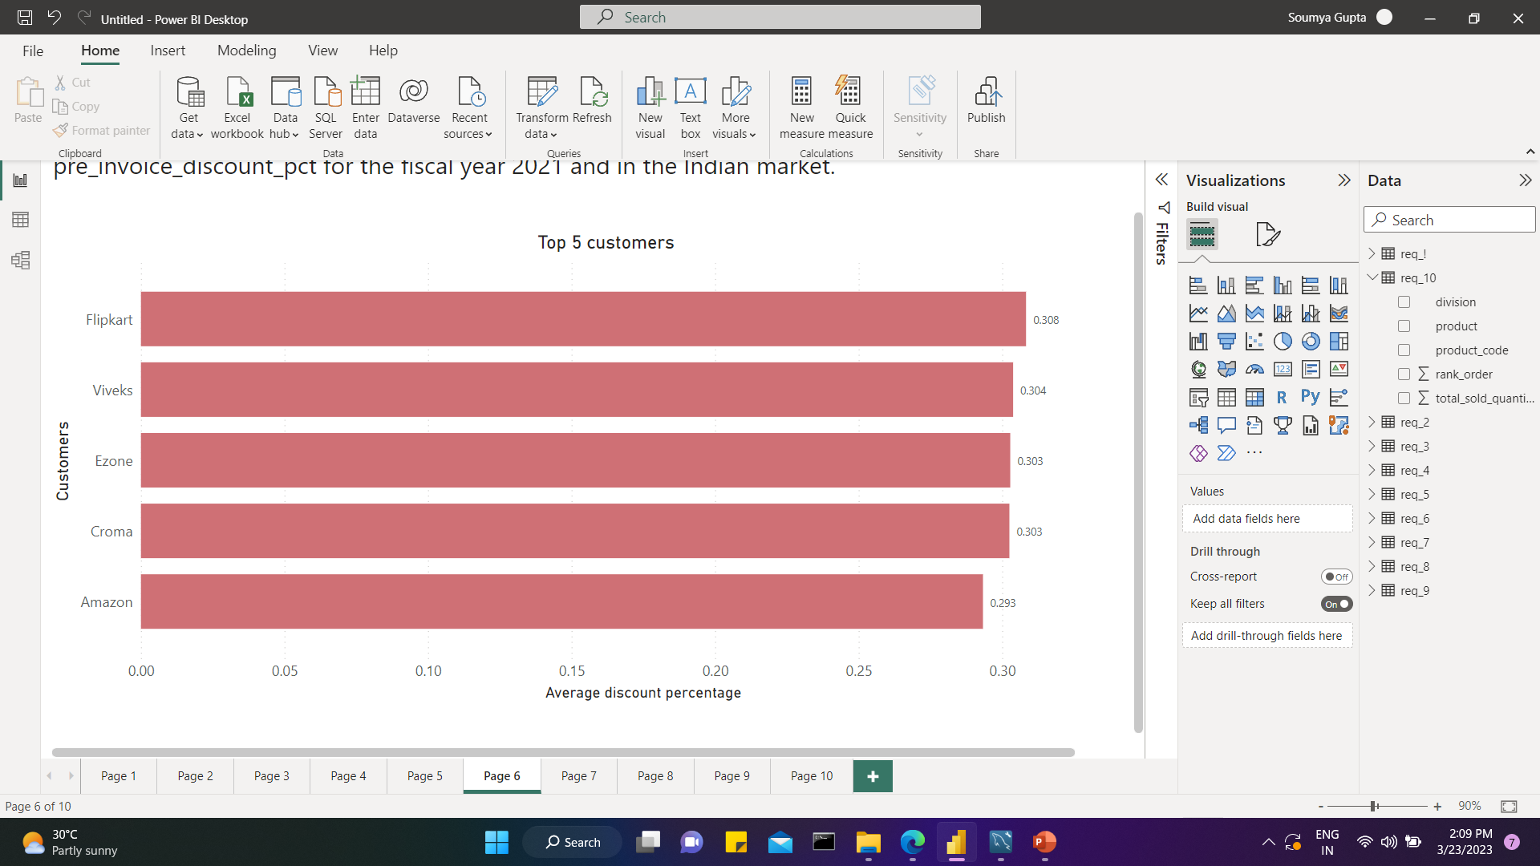
Generate a report which contains the top 5 customers who received an average high pre_invoice_discount_pct for the fiscal year 2021 and in the Indian market.
Req 6
INSIGHTS
➢ Among AtliQ’s top 5 customers getting average high pre invoice discount exclusively in INDIAN market are Brick & Mortar retailer Vivek, Ezone and Croma and the E- commerce retailer Amazon, Flipkart.
➢ Of these, Flipkart is the most valuable customer of Indian market in fiscal year 2021 receiving highest pre-invoice discount of 30%

Slide 12
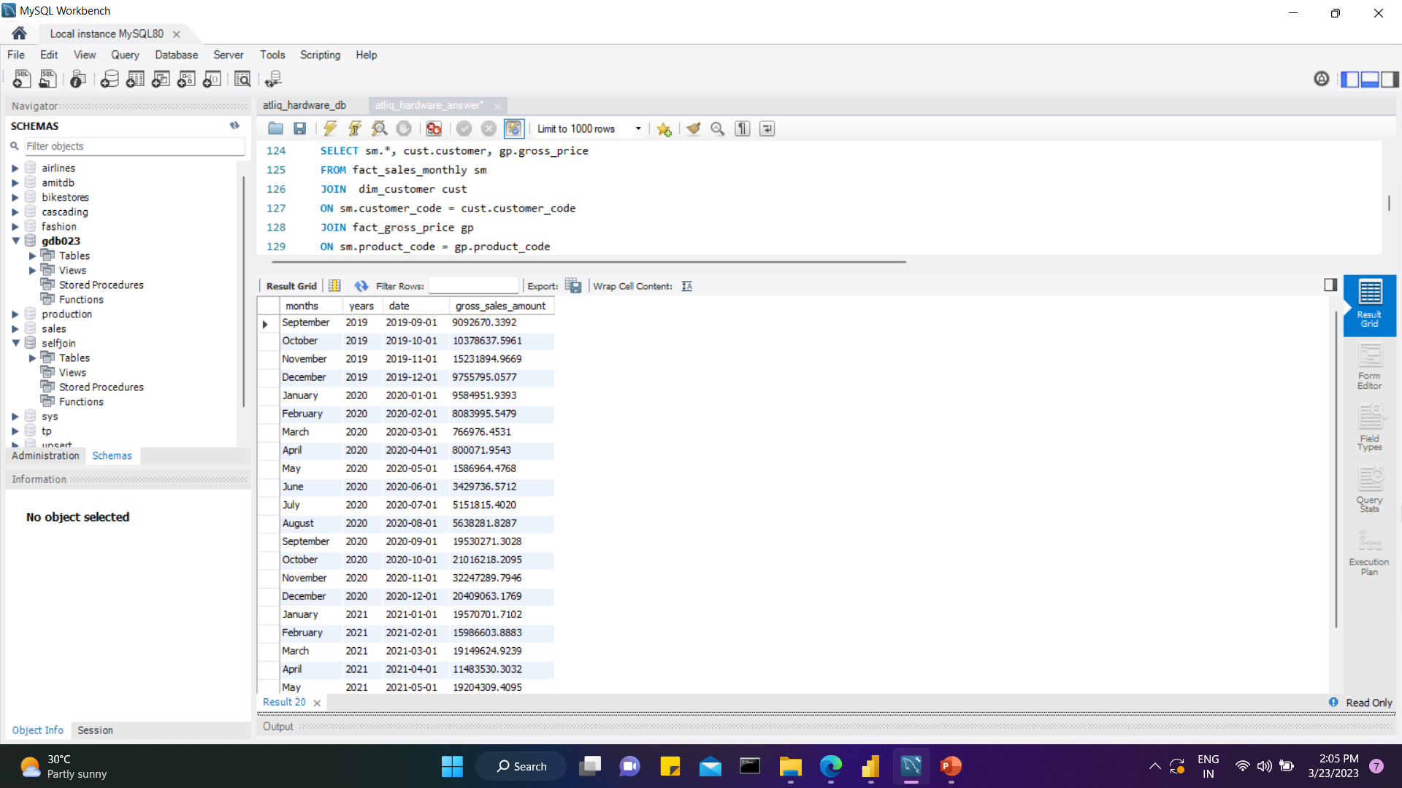
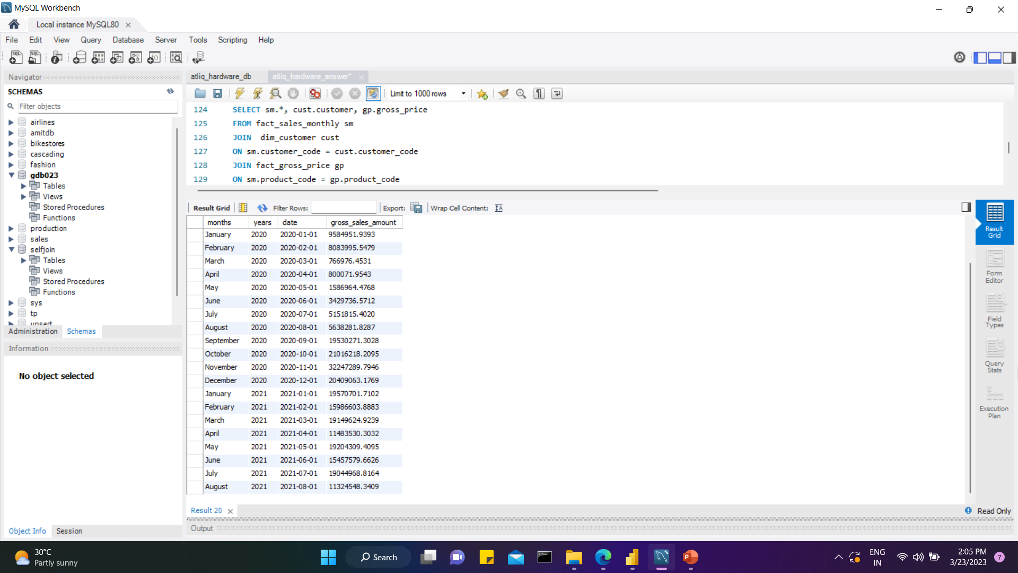
Get the complete report of the Gross sales amount for the customer “Atliq Exclusive” for each month . This analysis helps to get an idea of low and high-performing months and take strategic decisions.
Req 7
INSIGHTS
➢ Being a physical store AtliQ-Exclusive’s gross sales had significantly dropped during the lockdown period between March and August in FY 2020 due to COVID 19. However AtliQ recovered quickly after August and in November, it experienced the highest sales in last two fiscal years.

Slide 13
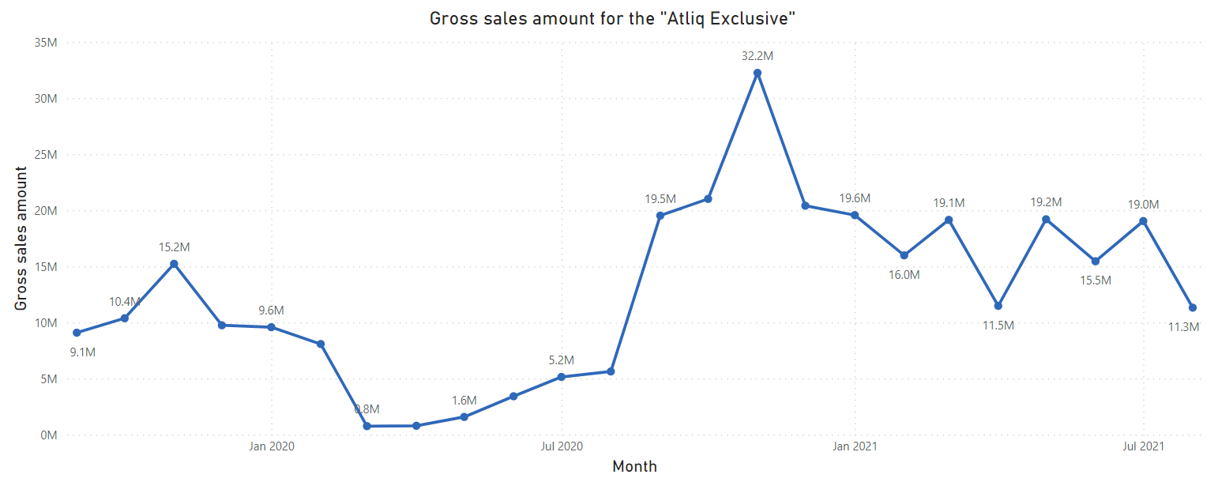

Slide 14
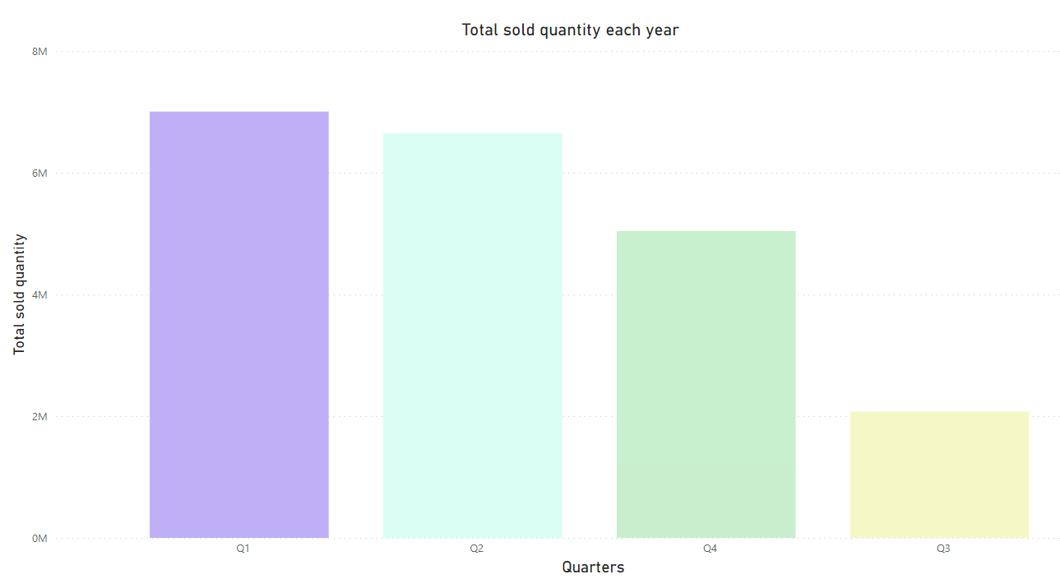
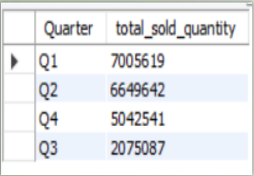
In which quarter of 2020, got the maximum total_sold_quantity?
Req 8
INSIGHTS
➢ Quarter 1 (sept 2020- nov 2020) of FY 2020 got the maximum total sold quantity
➢ The sales dropped drastically in Q3(March, April, May) of FY 2020 due to shutdown in Covid 19.

Slide 15
➢ AtliQ survived quickly from pandemic and its sales skyrocketed by 143 % in Q4 from Q3. The hit was probably due to high demand of desktop, laptop for sudden rise of online classes, online conference, meetings, WFH in the shutdown period. Also AtliQ’s 72% customers are E-commerce and AtliQ upgraded their products in high demanding desktop segment, which is 214% (ref. req 4).
So AtliQ played strategically and took advantage of its strengths, which paid off.

Slide 16
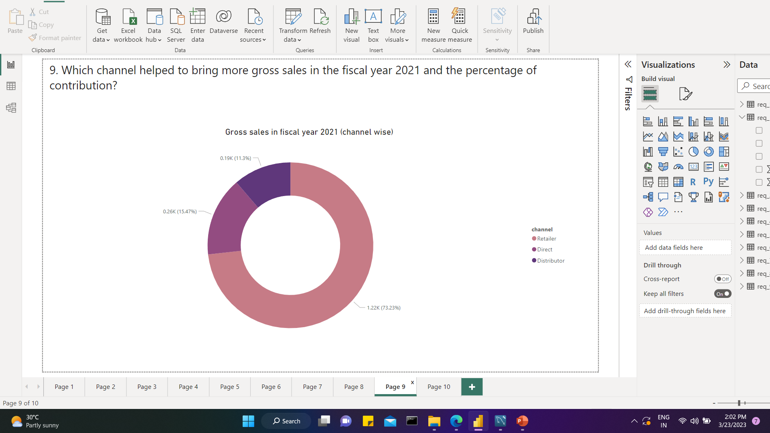
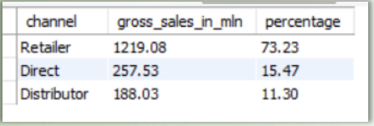
Which channel helped to bring more gross sales in the fiscal year 2021 and the percentage of contribution?
Req 9
INSIGHTS
➢ Retailer accounted for the majority of sales in AtliQ, which is 73.23% of total sales in fiscal year 2021.
➢ Direct and Distributor bring 15.47% and 11.3% gross sales accordingly in fiscal year 2021

Slide 17
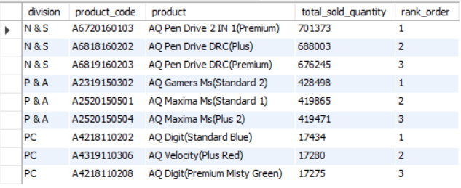
Get the Top 3 products in each division that have a high total_sold_quantity in the fiscal_year 2021?
Req 10
➢ Top 3 products by sold quantity in FY 2021 are different variant of Pen Drives in N & S division, different variant of Mouse in P & A division and different variant of Personal laptop in PC division.
INSIGHTS

Slide 18
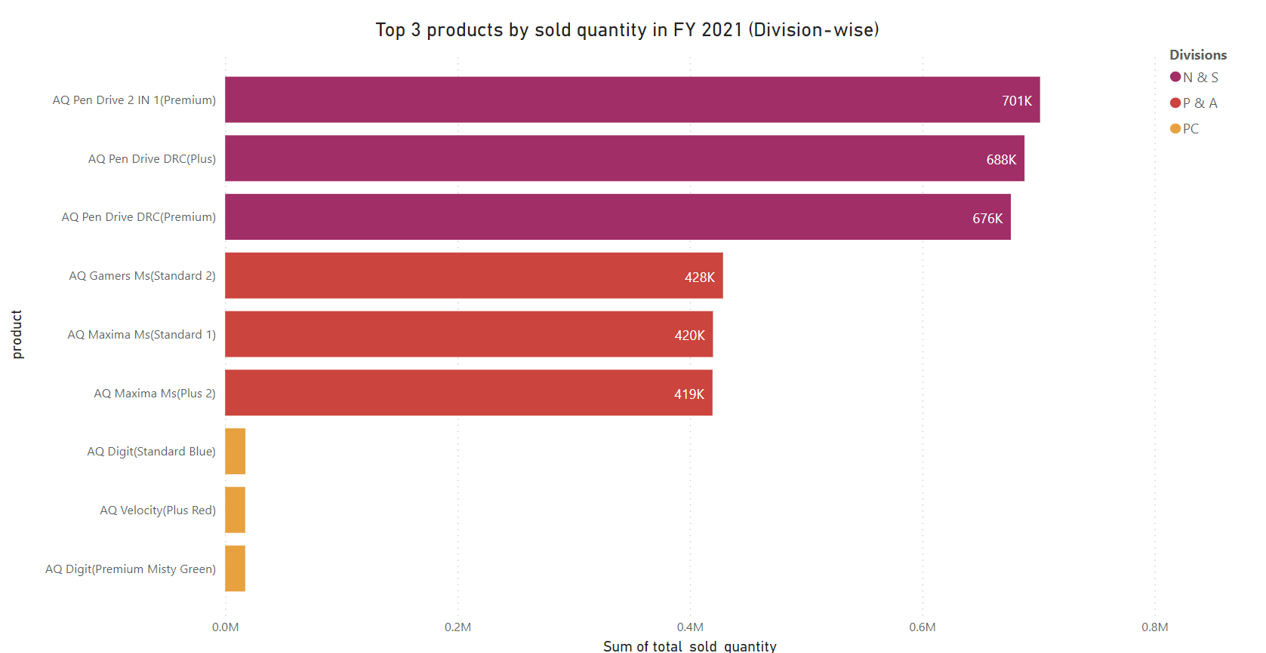

Slide 19
SUMMARY
Consolidating all :
AtliQ’s gross sales increased in FY 2021.
AtliQ is changing and modifying its products which has become a profitable exercise.
Network & Storage division sold maximum quantity product in FY 2021. Although it brought only 12% of total gross sales amount. Also considering the fact that this division had the least modification of product, I would like to suggest AtliQ to revise products sale price and introduce new products in Network & Storage division

